Slide 1
Topics To Be Covered
Asymptotic Analysis – Part II
Orders of Growth
  Big Oh Notation
  Omega Notation
  Theta Notation
Examples

Slide 2
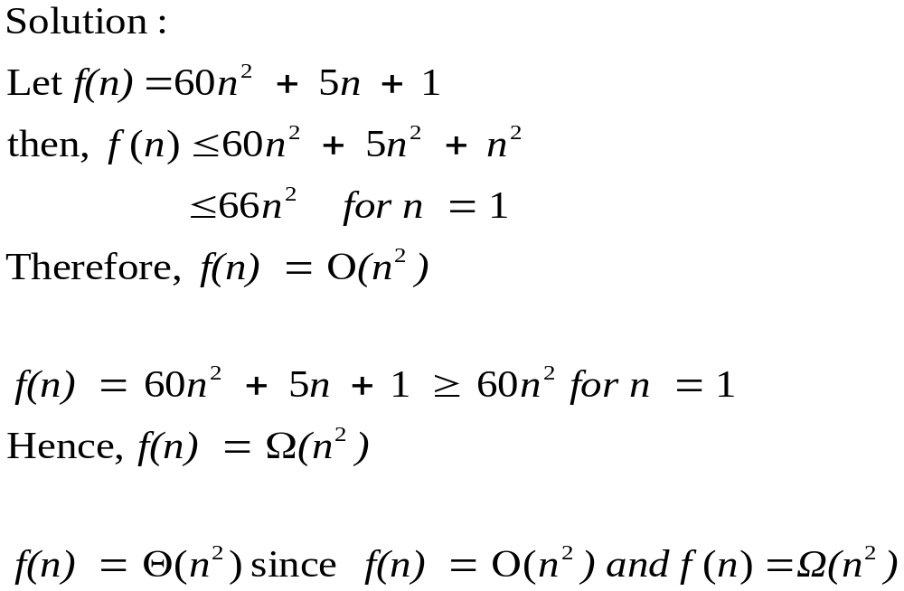
Complexity - Review
Example: Show that 60n² + 5n + 1 is of order n²

Slide 3
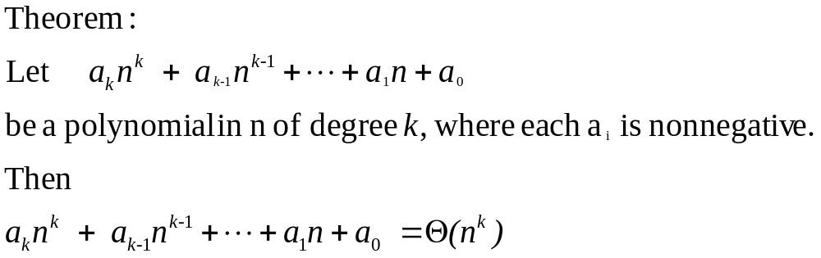
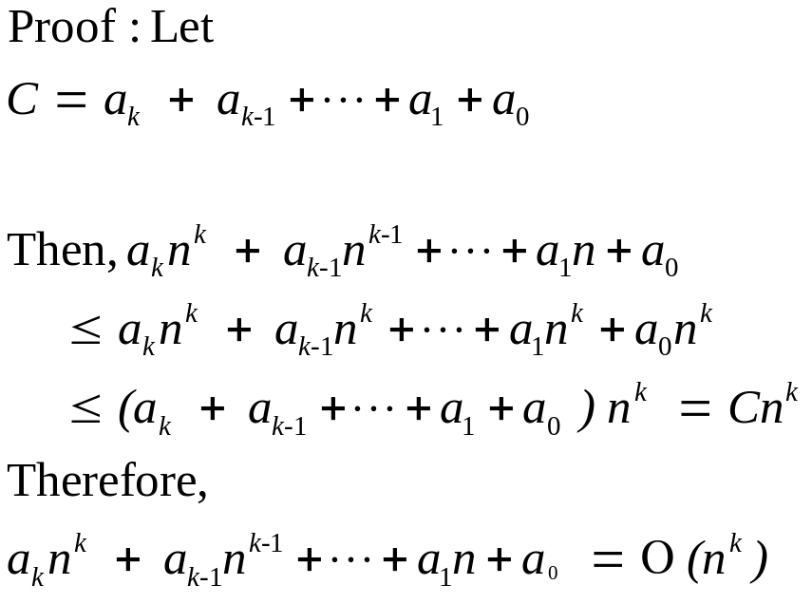
Complexity of Polynomial Functions

Slide 4
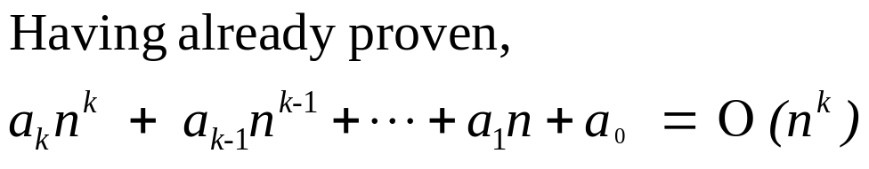
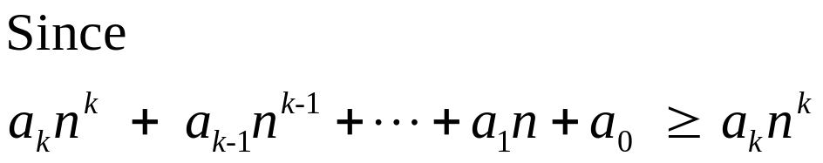
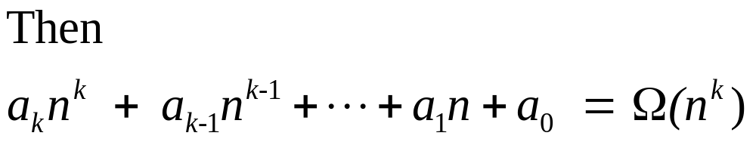
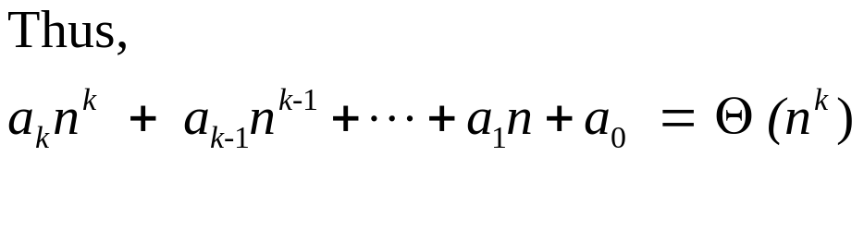
Complexity of Polynomial Functions

Slide 5
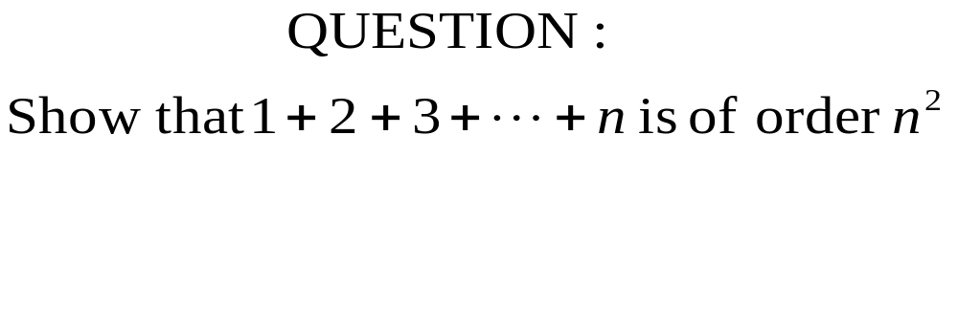
Complexity Analysis – Example 1

Slide 6
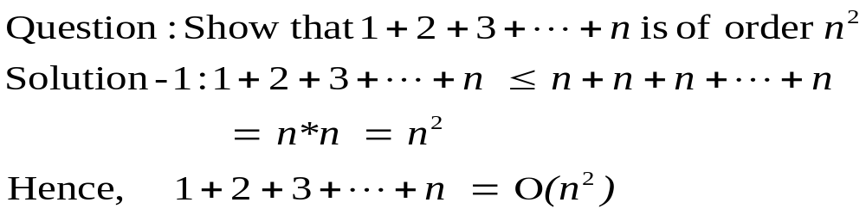
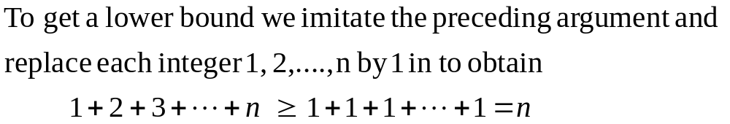
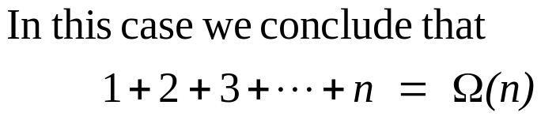
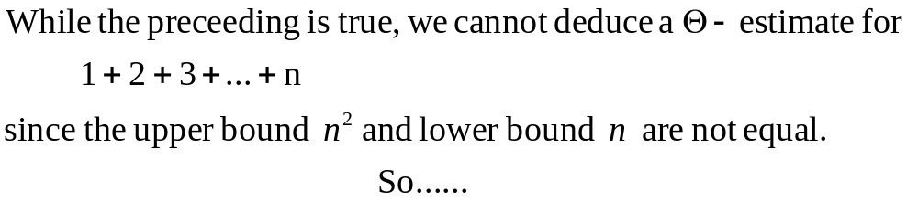
Solution – Example 1

Slide 7
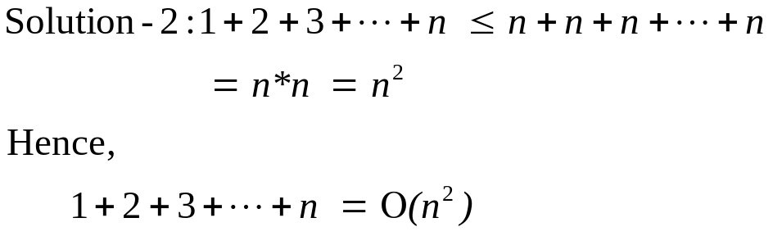
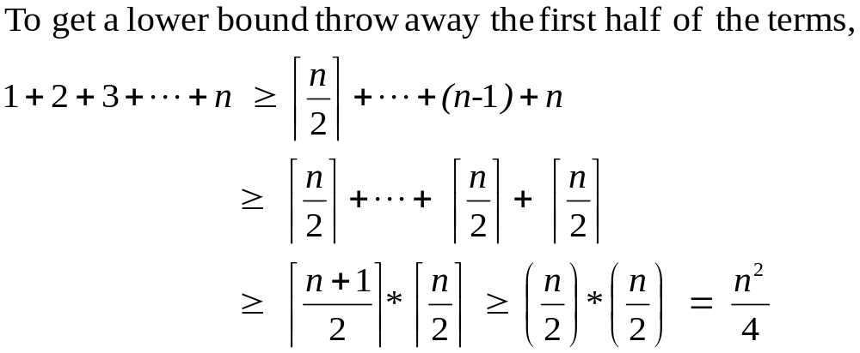
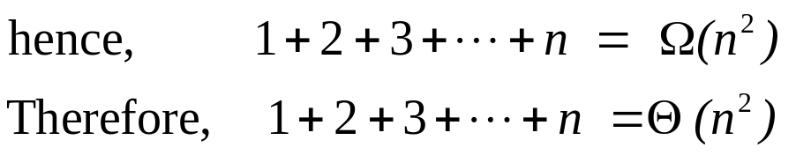
Solution – Example 1

Slide 8
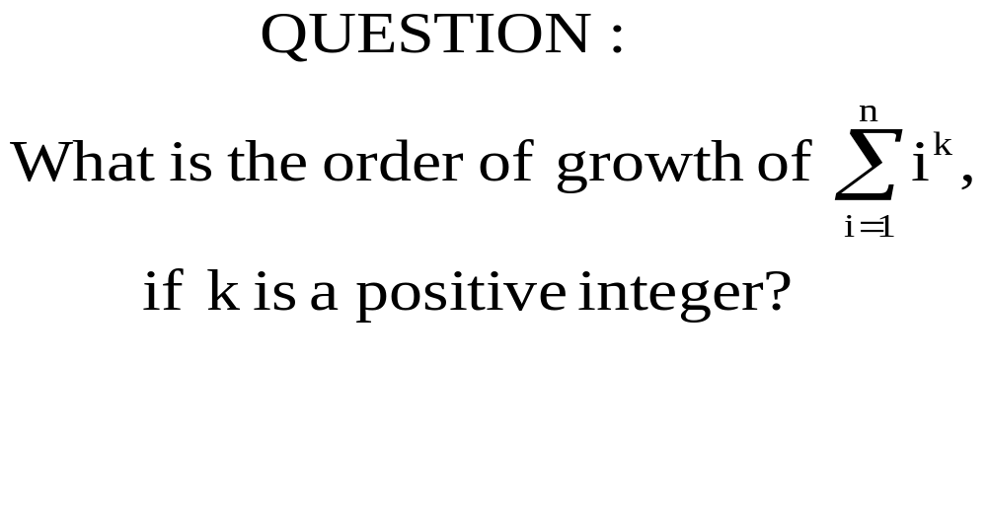
Complexity Analysis – Example 2

Slide 9
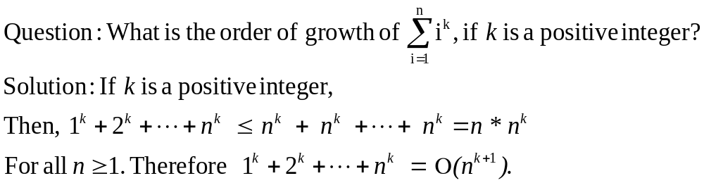
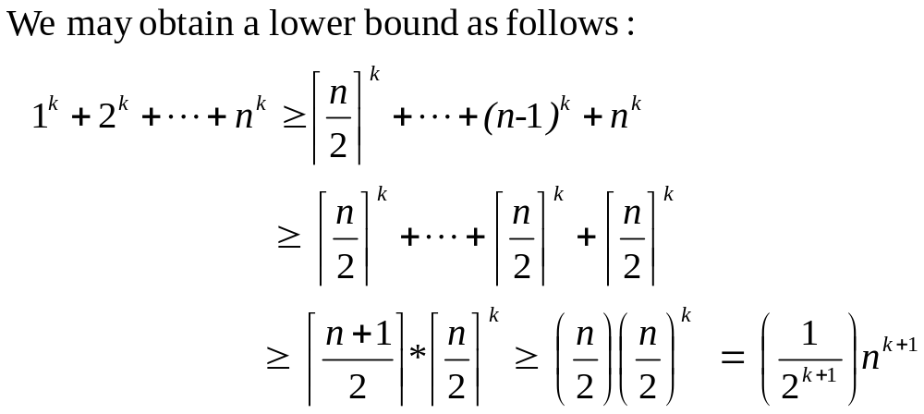
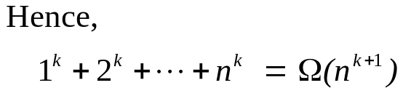
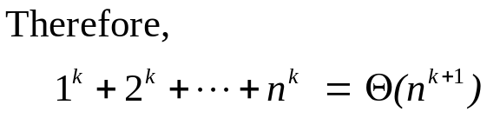
Solution – Example 2

Slide 10
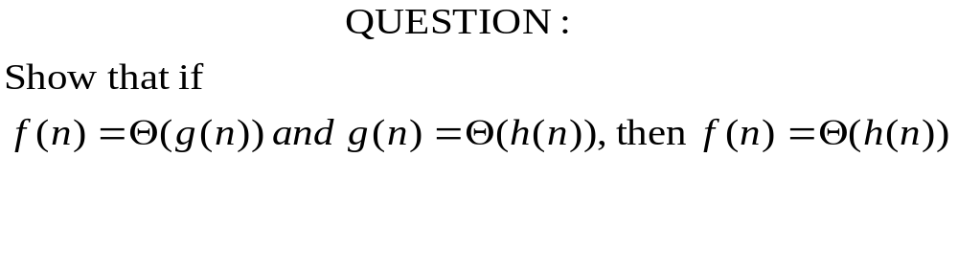
Complexity Analysis – Example 3
Notes:
Include slides on limit approach to complexity analysis

Slide 11
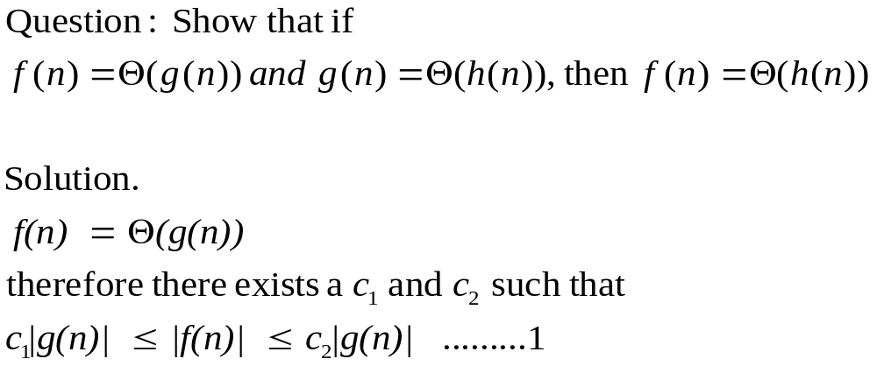
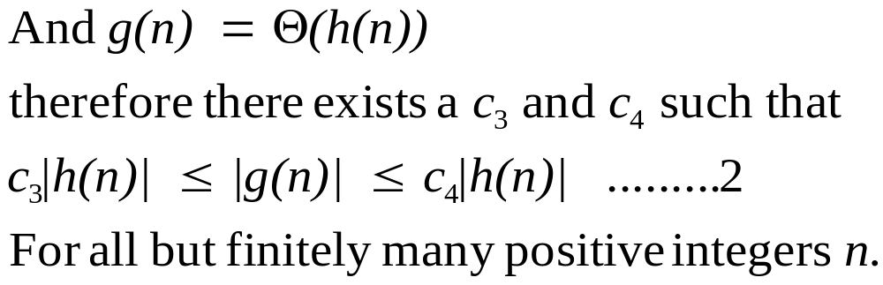
Solution – Example 3
Notes:
Include slides on limit approach to complexity analysis

Slide 12
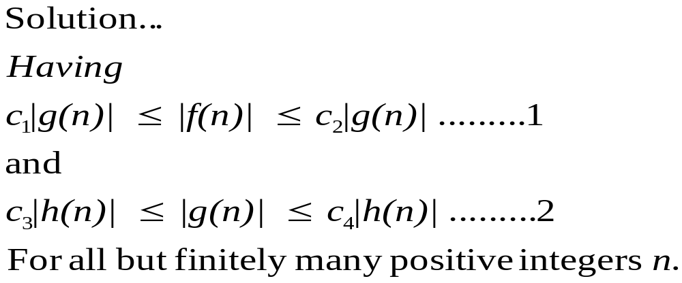
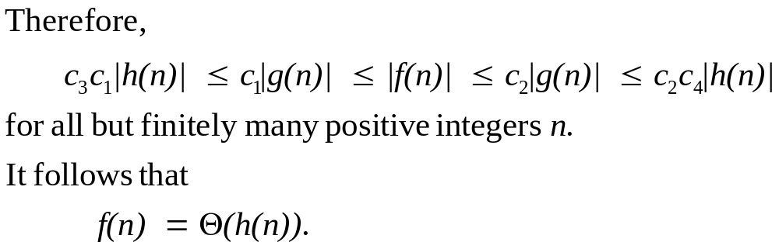
Solution – Example 3
Notes:
Include slides on limit approach to complexity analysis

Slide 13
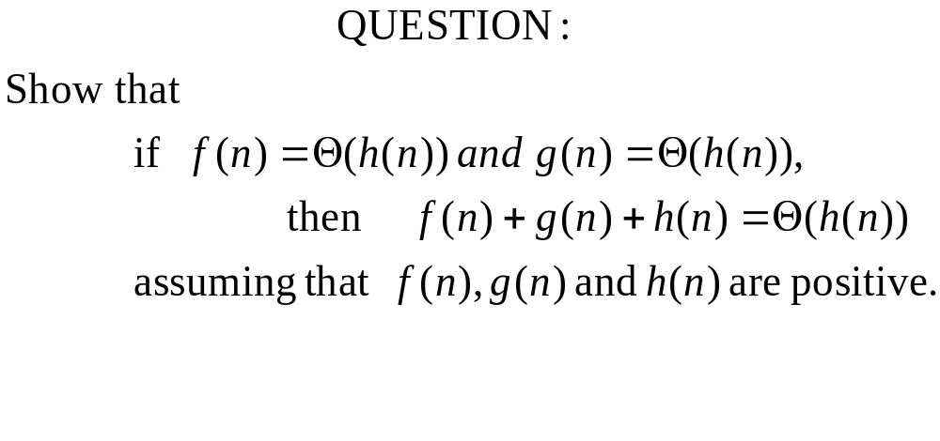
Complexity Analysis – Example 4
Notes:
Include slides on limit approach to complexity analysis

Slide 14
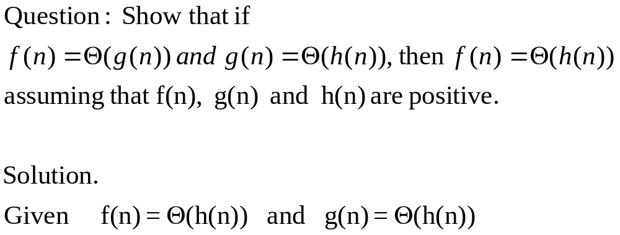
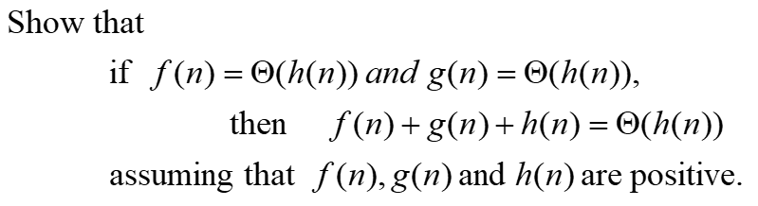
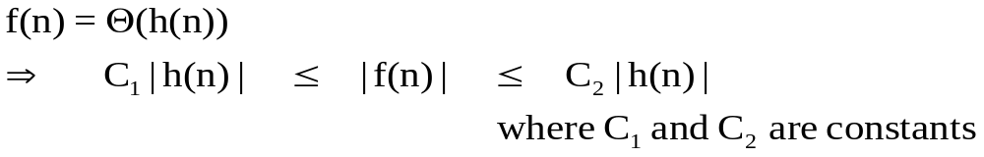
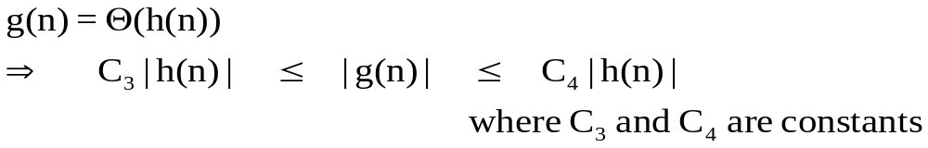
Solution – Example 4
Notes:
Include slides on limit approach to complexity analysis

Slide 15
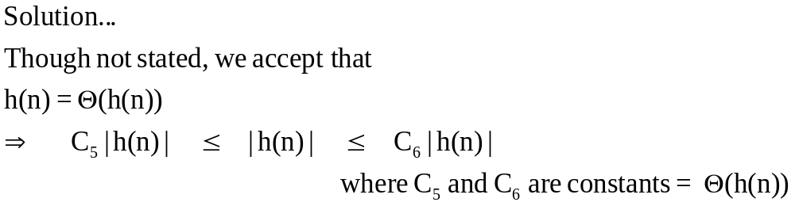
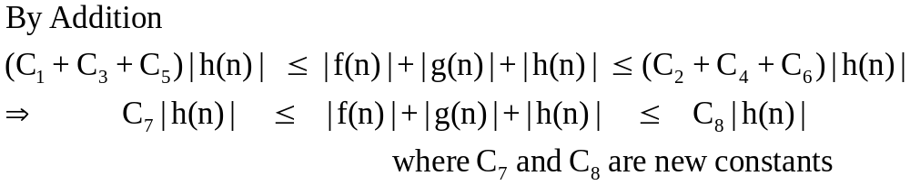
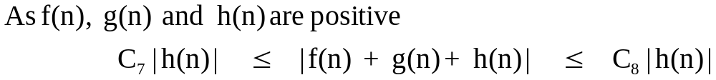
Solution – Example 4
Notes:
Include slides on limit approach to complexity analysis

Slide 16
Topics Covered
Asymptotic Analysis – Part II
Orders of Growth
  Big Oh Notation
  Omega Notation
  Theta Notation
Examples

